Slide 1
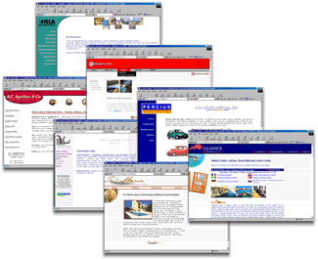
Web Technologies
Computer Science Course
Michal Puheim

Slide 2
Welcome!!!

Slide 3
Expectations?

Slide 4
To-do list for today
Difference between web & internet
Webpage fundamentals
Hypertext transfer protocol
Create simple website

Slide 5

What is the Internet?

Slide 6

What is the Web?

Slide 7
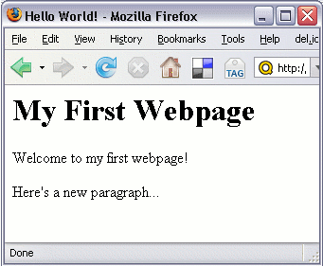
What is a webpage?

Slide 8
What is a webpage?
Document on the web?

Slide 9
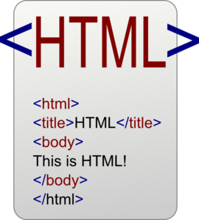
What is a webpage?
Document written in HTML

Slide 10
Webpage content
HTML = Hypertext markup language
May contain elements such as:
Text
Hyperlinks
Images
Video
Audio

Slide 11
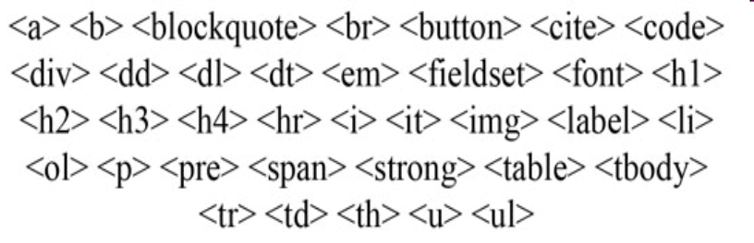
Webpage content
HTML = Hypertext markup language
May contain elements such as:
Text
Hyperlinks
Images
Video
Audio
HTML Tags

Slide 12
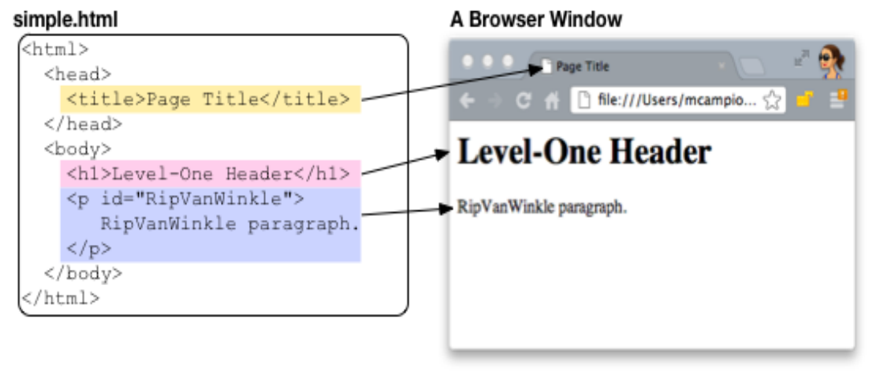
Webpage content
HTML Source Code
Result

Slide 13
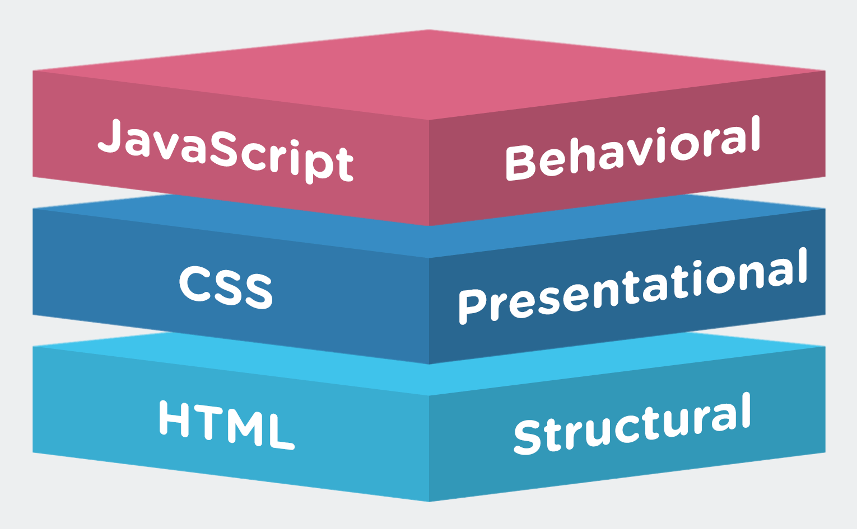
Structure of a modern webpage
Content
HTML
Visuals
CSS
Functionality
Javascript

Slide 14
Structure of a modern webpage
Content
HTML
Visuals
CSS
Functionality
Javascript (in browser)
+ server side scripts:
Hypertext preprocessor (PHP)
Other scripting backend (e.g. Python Flask)

Slide 15
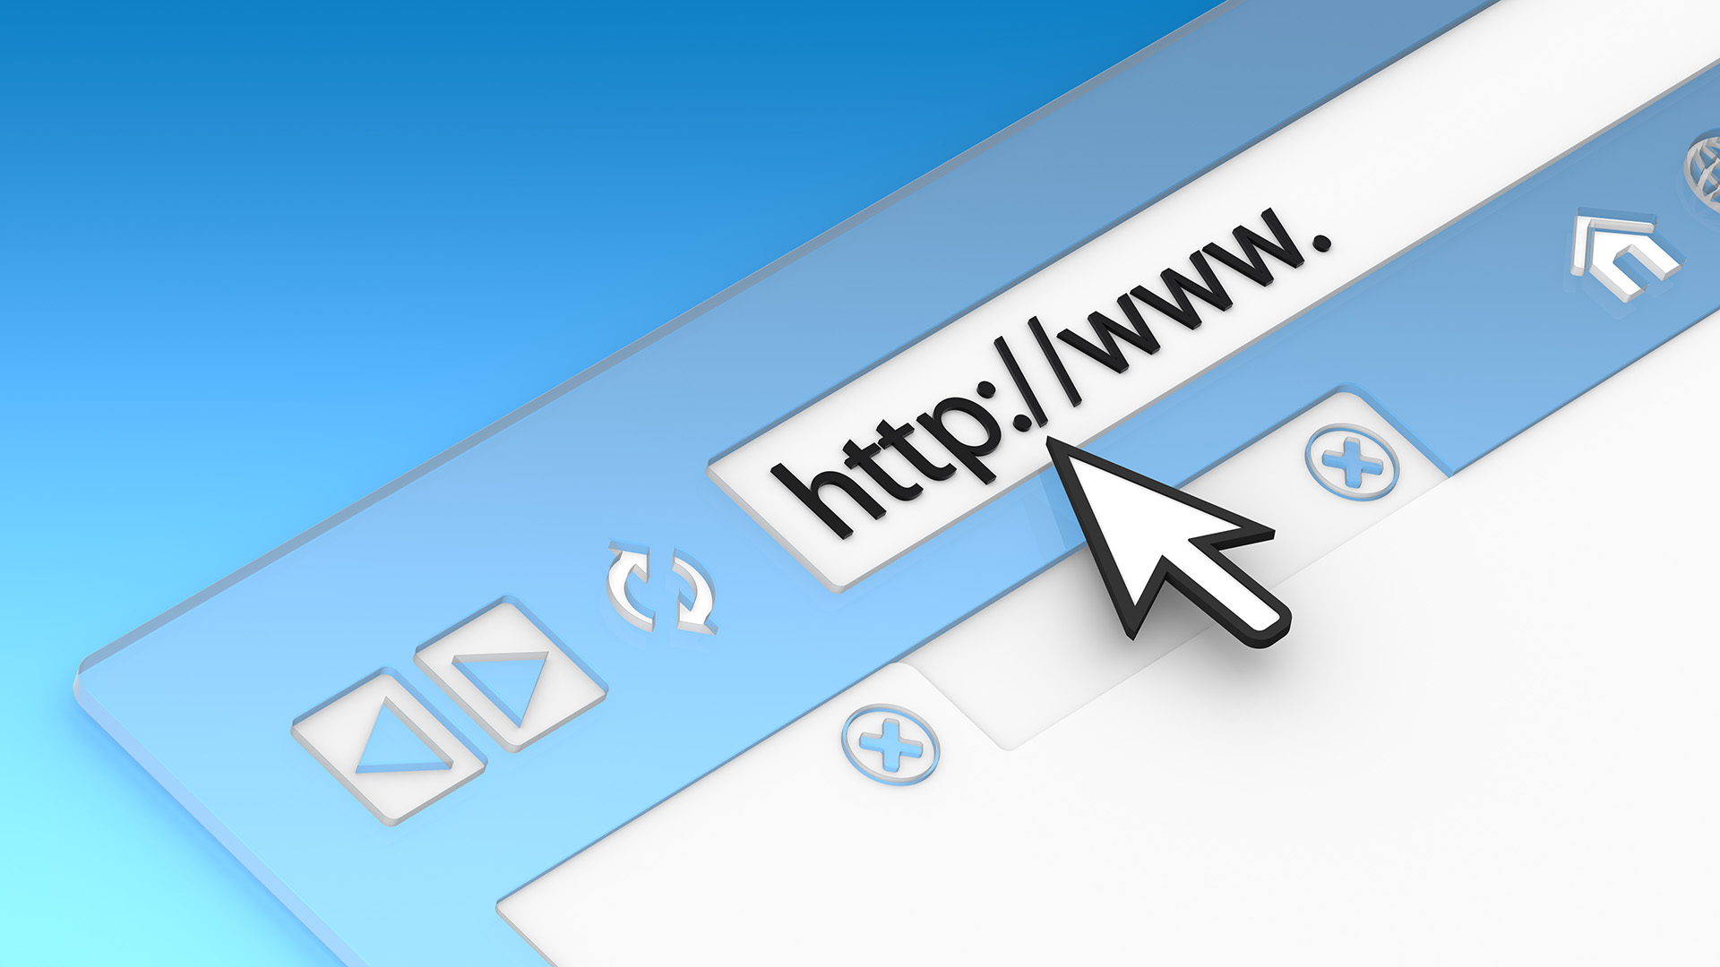
How are webpages accessed?

Slide 16
How are webpages accessed?
Web address
URL = Uniform Resource Locator
URI = Uniform Resource Identifier
Domain name / specific page path
Examples:
www.kosice.sk
gymes.edupage.org/subjects

Slide 17

Where are webpages stored?

Slide 18
How are webpages retrieved?

Slide 19
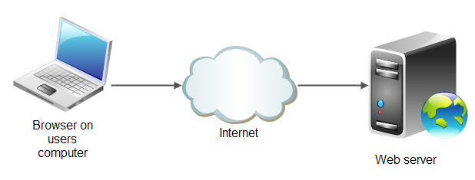
How are webpages retrieved?
HTTP GET
Request
HTTP GET
Request
Response
Response
https://en.wikipedia.org/wiki/Hypertext_Transfer_Protocol

Slide 20
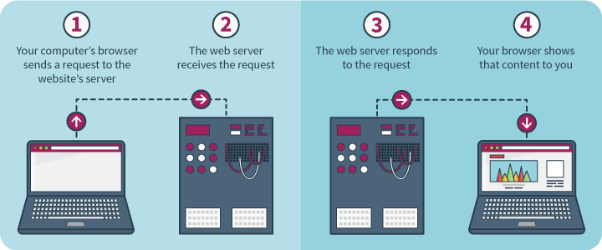
How are webpages retrieved?

Slide 21

Why is this important?

Slide 22
Finally!!!

Slide 23
Initial setup
Setup the network accessed storage (NAS) @ gymeske.synology.me
Login: NameSurname
Pass: password123
Change your password after logon!
Create subfolder for your files in the “Portfolio” folder named using your
Name Surname
Set folder permissions / disable access to group sINF2020
https://en.wikipedia.org/wiki/File_system_permissions | www.oskole.sk/?id_cat=2010&clanok=17583

Slide 24
Task
Create a simple webpage:
https://www.w3schools.com/html/html_intro.asp
https://www.w3schools.com/html/html_editors.asp
Save the page as an HTML file to the NAS inside your portfolio folder:
./Portfolio/Name Surname/L1-Intro/initial.html

Slide 25
Additional references
W3Schools tutorials:
https://www.w3schools.com/
HTML, CSS, Javascript Cheatsheet
https://html-css-js.com/
Crash Course Computer Science:
Networks: https://youtu.be/3QhU9jd03a0
Internet: https://youtu.be/AEaKrq3SpW8
Web: https://youtu.be/guvsH5OFizE

